Slide 1


Final Project Presentation
Submitted By : Group 5
Submitted To: Fairoza Amira Bintihamzah
Web Programming 1

Slide 2
Table of content
Project Introduction
Company Introduction
Group Member
Services
Product Plans
Reason to choose us

Slide 3
Project Introduction
This is a team project of web programming first that is done by using HTML and CSS web technology. For this project we create a website for IT company. Our company name is KINGS SOFTWARE GROUP.
We tried our best to give the test of how software company web pages looks like. Most of the IT company has common webpages to introduce them with customers and other people. So our project contains 5 webpages. That are:
Home page
About Us page
Service page
Customer page
Contact Us page

Slide 4
Company Introduction
Nepal Based startup Software and IT Company located at Kumaripati, Kathmandu.
Our Motto “Use King's product to be the king in your business”
We have been established with aim of web development, software development, web hosting and many more application developments with better quality
We also offer IT consultancy services to different corporate, organization and offices.

Slide 5
Group Members
We have very young, energetic and dynamic team for the rapid growth of our company. We are team of highly experience engineers.
Our team member are:
Shrestha Suman (Manager/ software engineer)
Bivek Dhimal (Web developer)
Bhuwan Sapkota (Marketing Director)
Basanta Regmi (Web Hosting and SEO Expert)
Sapana Kunwar (Content Writer)

Slide 6
Services
We provides many more services related to web development, apps development and many more. The following are the specific services provided by our company:
Web Site development
Android app development
Web hostin g and Search engine optimization and many more

Slide 7
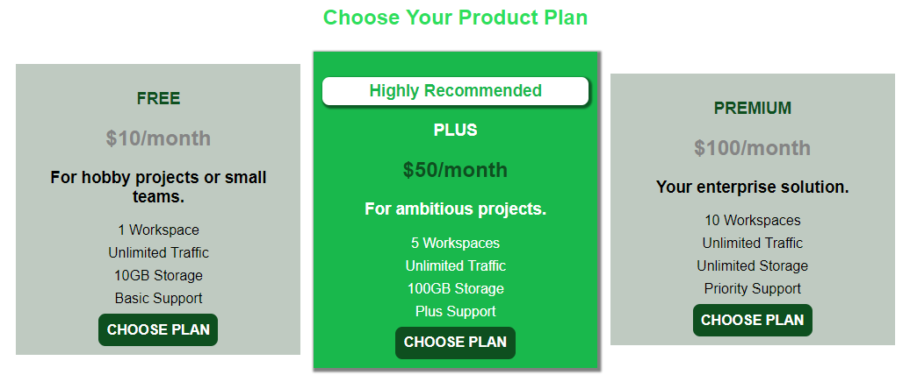
Product Plans For our Customers
We have categories our plan into 3 groups. They are shown in figure

Slide 8
Reason to choose us
Many trusting customer
There are many big financial and medical company who are using our product like Prime bank, NIC Asia Bank, Bir Hospital etc,
More than 15 product delivered
Most of our product are related to banks, hospital and schools.
Fast service

Slide 9
Thank you

